Slide 1
What Is the Project about?
Introduction

Slide 2

PLS HELP!
I am too tired!

Slide 3
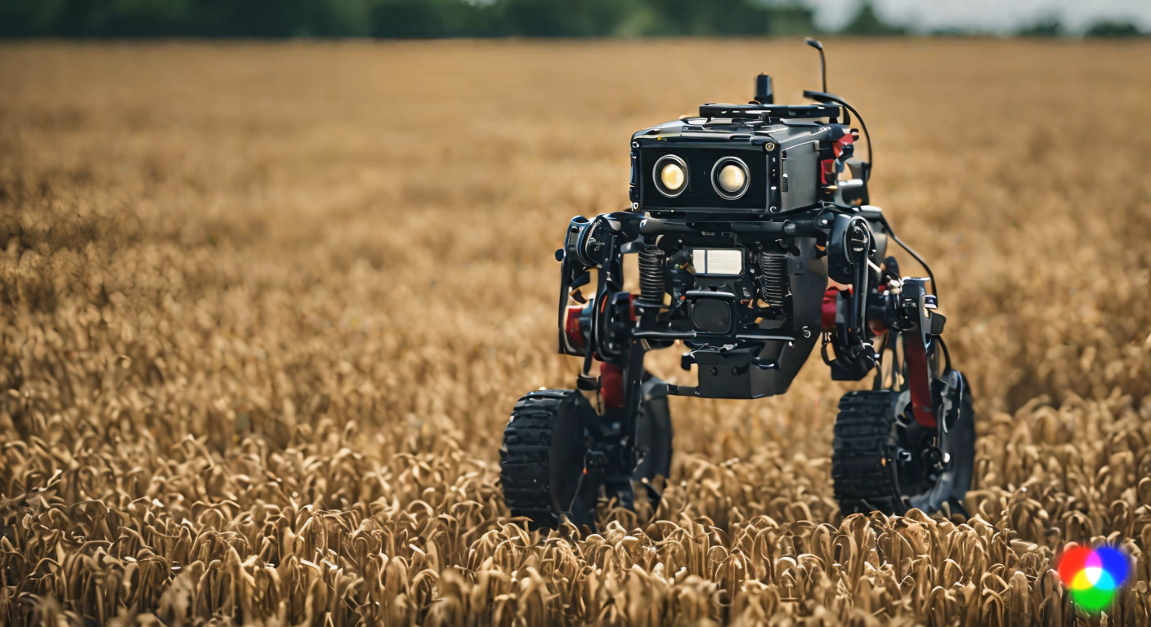
Now no more stress
For Farmers
AI will conquer the troubles of farmers.

Slide 4


Slide 5
Smart Irrigation System
A Smart Plant Watering System

Slide 6
Table of Contents
Introduction
Conclusion
1.
Aim
4.
Final Conclusion
ESP32
References
2.
Power of this module
5.
Reference Materials
Project Explanation
Thank you
3.
Detailed Project Explanation
6.
Thank You

Slide 7
What is the aim of the Project
Introduction

Slide 8
What is the aim of the Project
The aim of the project is to help the farmers and the crops.
The Project also can be used at home as Plant Watering System.
This Project will display the values of Humidity, Climate Temperature, Soil Moisture Level and the Pump Status.
The ‘OLED DISPLAY’ Will display the details mentioned above.
The Values can also be seen in the cloud through website or an app, from anywhere from the world.
The only thing is that the entire project requires constant internet supply.
This is helpful for the Homemakers who are tired of watering the plants in their homes.
But for the farmers there is no internet supply, so they can use the OLED Display to view the Data of the Soil Condition, Humidity and the Temperature.
If the soil moisture is less, then the motor will automatically water the plants.

Slide 9
Whom will it help the most
Introduction

Slide 10
Whom will it help the most
This Project will help in Two Sectors:
Automatic Plant Watering System:
This will be used in homes where the plants will be watered automatically after the soil moisture decreases than the trigger level.
When the moisture level exceeds the trigger level it will start the pump motor and water the plants.
Smart Irrigation System
This will bee useful for the farmers for watering their plants automatically when there is rain the soil moisture increases and the pump motor ill not pump. But when there is no rain, the crops will receive water from nearby ponds by motorized/solenoid valve and from PVC Pipes water will flow and produce water to plants.
The Effort of farmers will decrease in this process.

Slide 11
Why did we choose this Project.
Introduction

Slide 12
Why did we choose this Project.
The main reason to choose this project is to help the people in their home to water their plants regularly.
To stop the global warming, the people have started plating some plants. But they are forgetting to water those plants regularly.
To stop this problem, this will monitor the plant’s soil water condition.
The another reason is that the farmers would have to roam in the sum and turn on the solenoid valve to water their crops, but with this device, it will water the crops automatically.
The efficiency of crop production will increase and the global warming will also be controlled in the near future if there were more plants.

Slide 13
Introduction to ESP32
ESP32

Slide 14
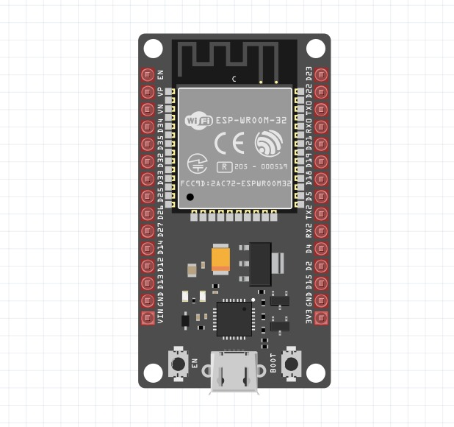
Introduction to ESP32
This Module is a powerful MICRO-CONTROLLER developed by Esspressif Systems. It is Cheap and it has wide range of Applications.
The Microcontroller Unit (MCU) of the ESP32 is a dual core Xtensa LX6 MCU, which operates up to 240 MHz
Having two cores, it is allowed for better multitasking and handling multiple process simultaneously.
One of the standout features is that, it has Built-in WI-FI and Bluetooth Module in it.
It supports 2.4GHz WI-FI and Bluetooth V4.2
This is the reason this makes this module suitable for IOT Projects.

Slide 15
Advantages of this Module
ESP32

Slide 16
Advantages of this Module
Low Power Consumption:
The ESP32 is designed in such a way that it is power efficient.
It also includes multiple power saving modes, such that it consumes less power even if it is Idle.
Security Features:
It includes hardware accelerated encryptions (AES, SHA-2, RSA, etc.).
It also includes secure boot, flash encryption and secure storage.
Development Environment:
The ESP-32 can be programmed using Arduino IDE which makes easy to develop the projects.

Slide 17
PIN Layout of ESP32
ESP32

Slide 18
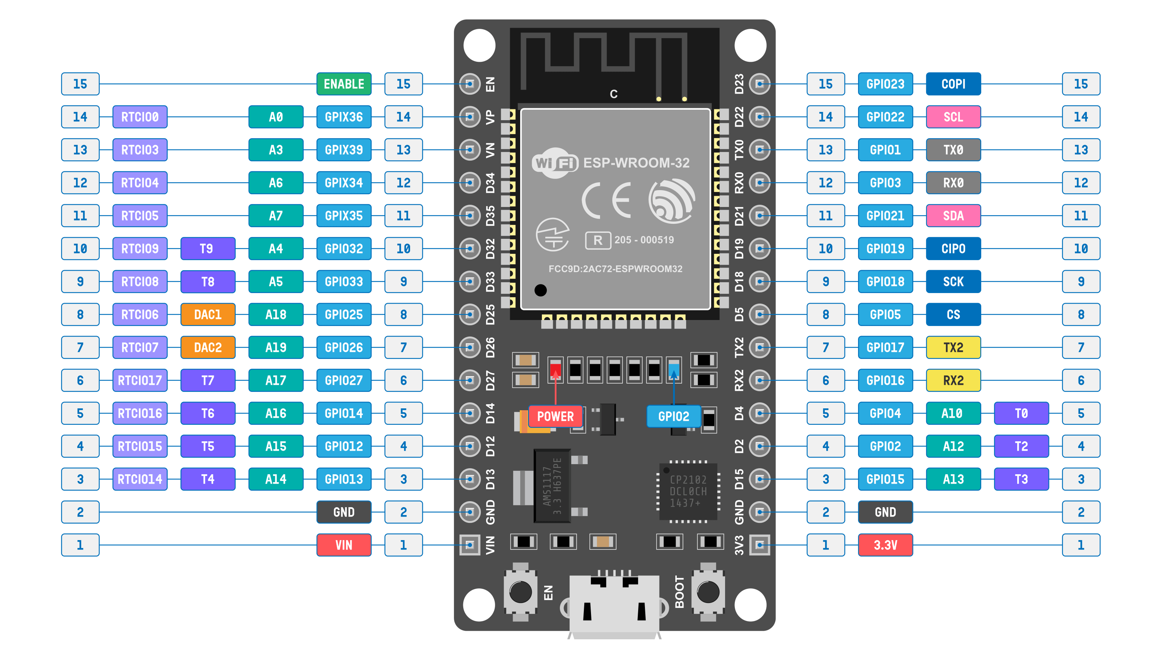
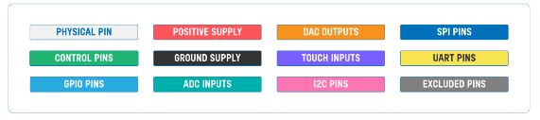
PIN Layout of ESP32

Slide 19
Components Used in this Project
Project Explanation

Slide 20
ESP32

Slide 21
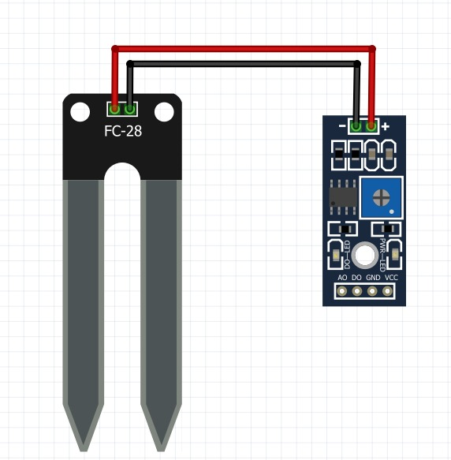
Soil Moisture Sensor

Slide 22
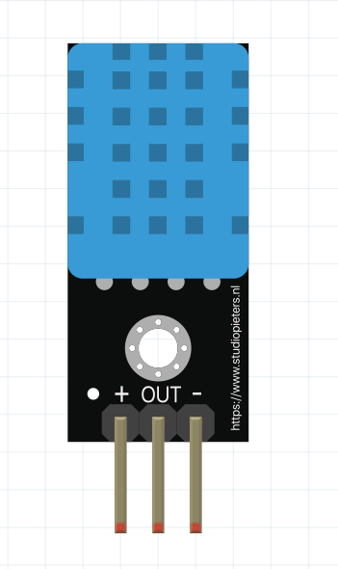
DHT11 Sensor

Slide 23
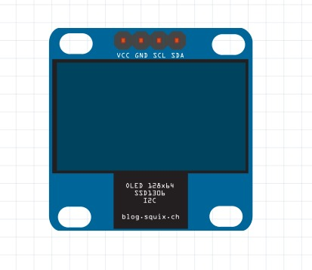
OLED Display

Slide 24
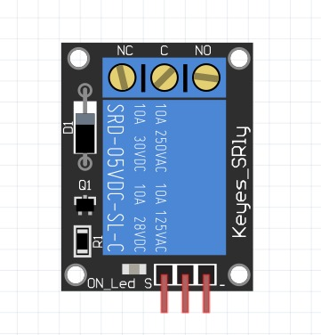
Keyes Relay Module

Slide 25

Pump Motor

Slide 26
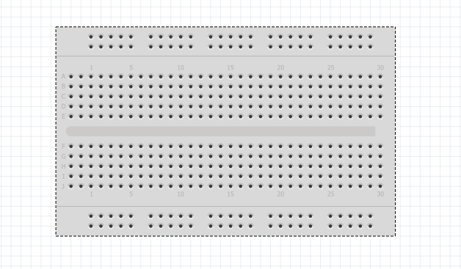
Breadboard

Slide 27
Working of the Project
Project Explanation

Slide 28
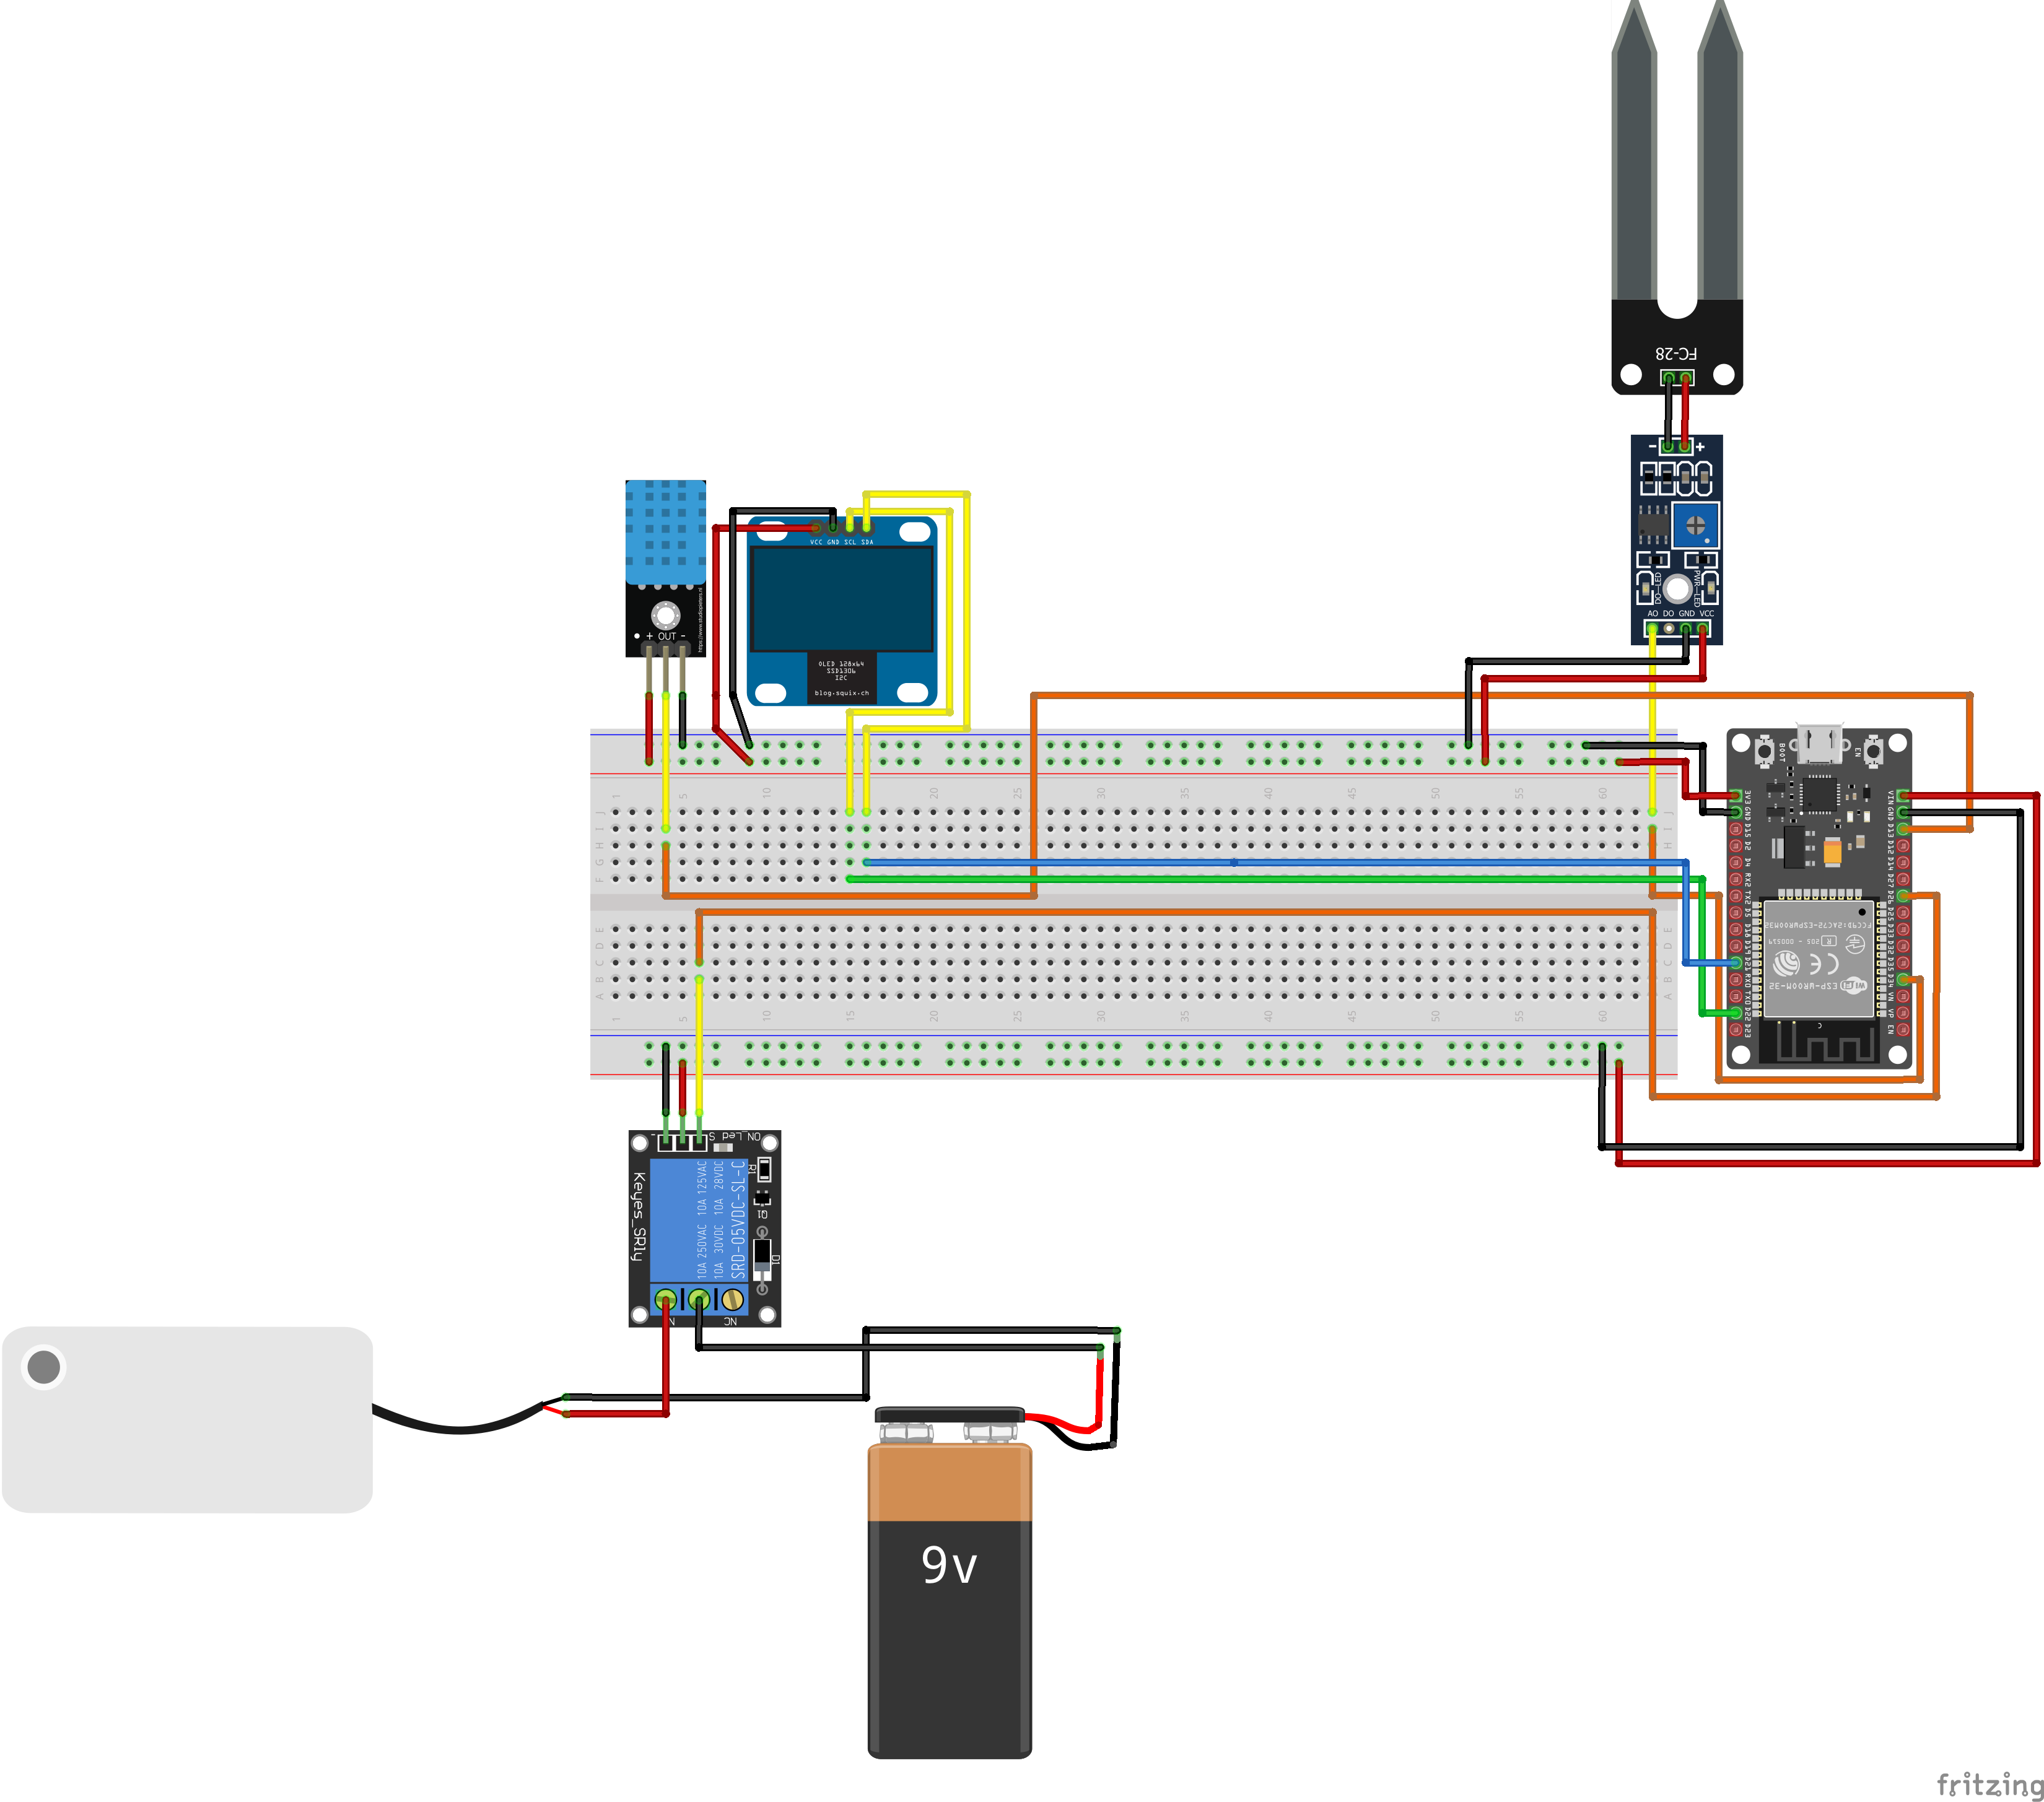
Circuit Diagram

Slide 29
Pins Connection
Pins of Module to ESP32
OLED Display
SDA – D22
SCL – D21
DHT11 Humidity/Temperature Sensor
OUT – D13
Soil Moisture Sensor
A0 – D34
Keyes Relay
Signal – D26

Slide 30
Working
The OLED Display will show the output of all the Sensors.
The Soil Moisture Sensor will take an analog input and sends it to the ESP32 Module.
The Module Communicates with the network and send the data to the cloud.
Those Values are displayed in the Dashboard which we will see later.
Next the DHT11 Sensor takes its action.
The DHT11 Sensor Takes the Input of Humidity and sends the analog input to the ESP32 Module.
The Module will communicate with the cloud through internet and displays the values in the Dashboard.
The ESP32 Module based on the trigger level, sends the output signals to the relay module.
The Relay receives the output signal from ESP32 and turns On/Off the Pump Motor.
The ESP32 plays major role in transferring the data from the sensors and sends back to cloud.
The Module can send the data to the user from anywhere from the world.

Slide 31
Source Code
Project Explanation

Slide 32
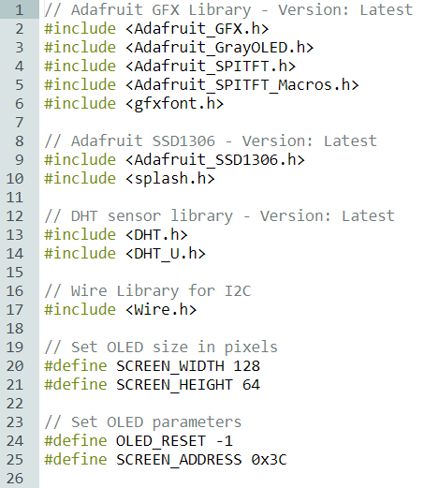
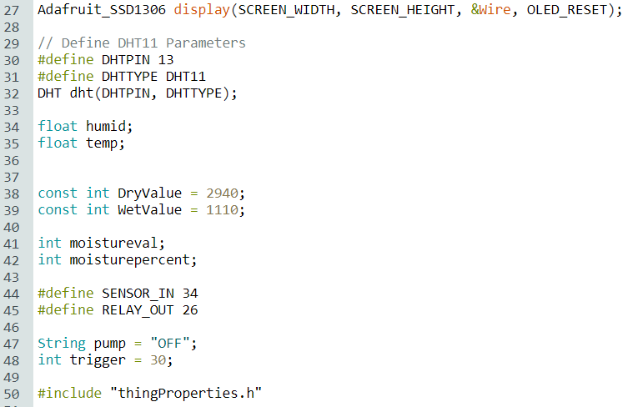
Source Code – Libraries and Local Variables

Slide 33
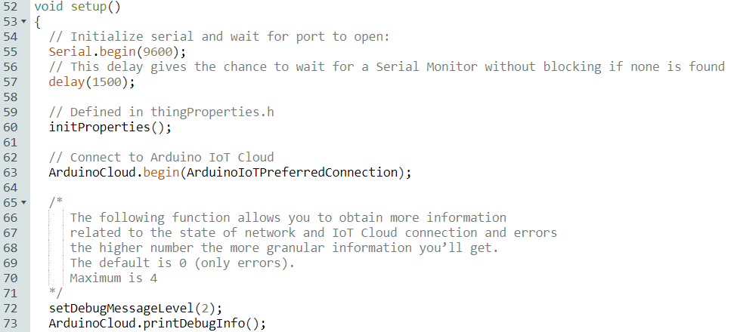
Source Code – Void Setup

Slide 34
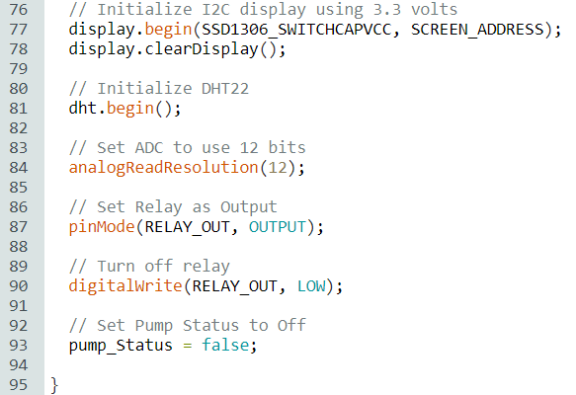
Source Code – Void Setup

Slide 35
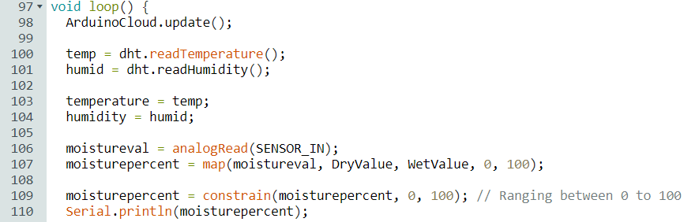
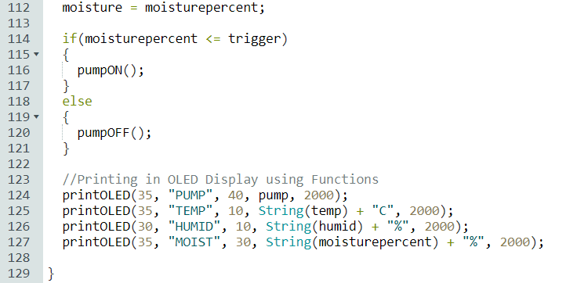
Source Code – Void Loop

Slide 36
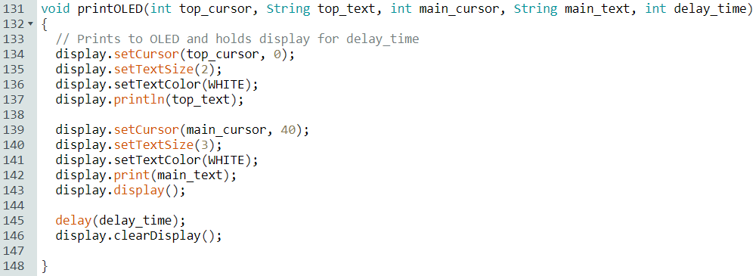
Source Code – Function printOLED()

Slide 37
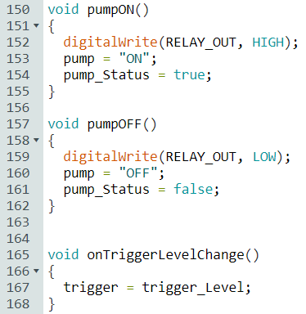
Source Code – Function Pump ON/OFF | Trigger

Slide 38
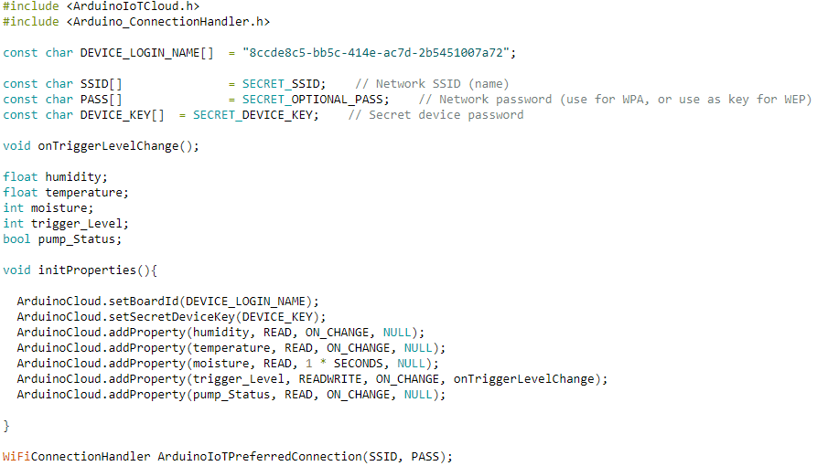
Cloud Variables and Functions

Slide 39
Dashboard
Project Explanation

Slide 40
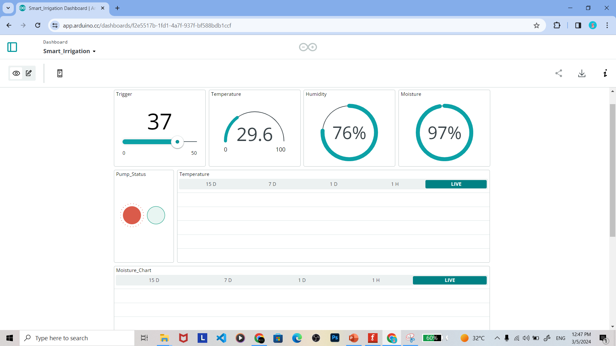
Computer Dashboard

Slide 41
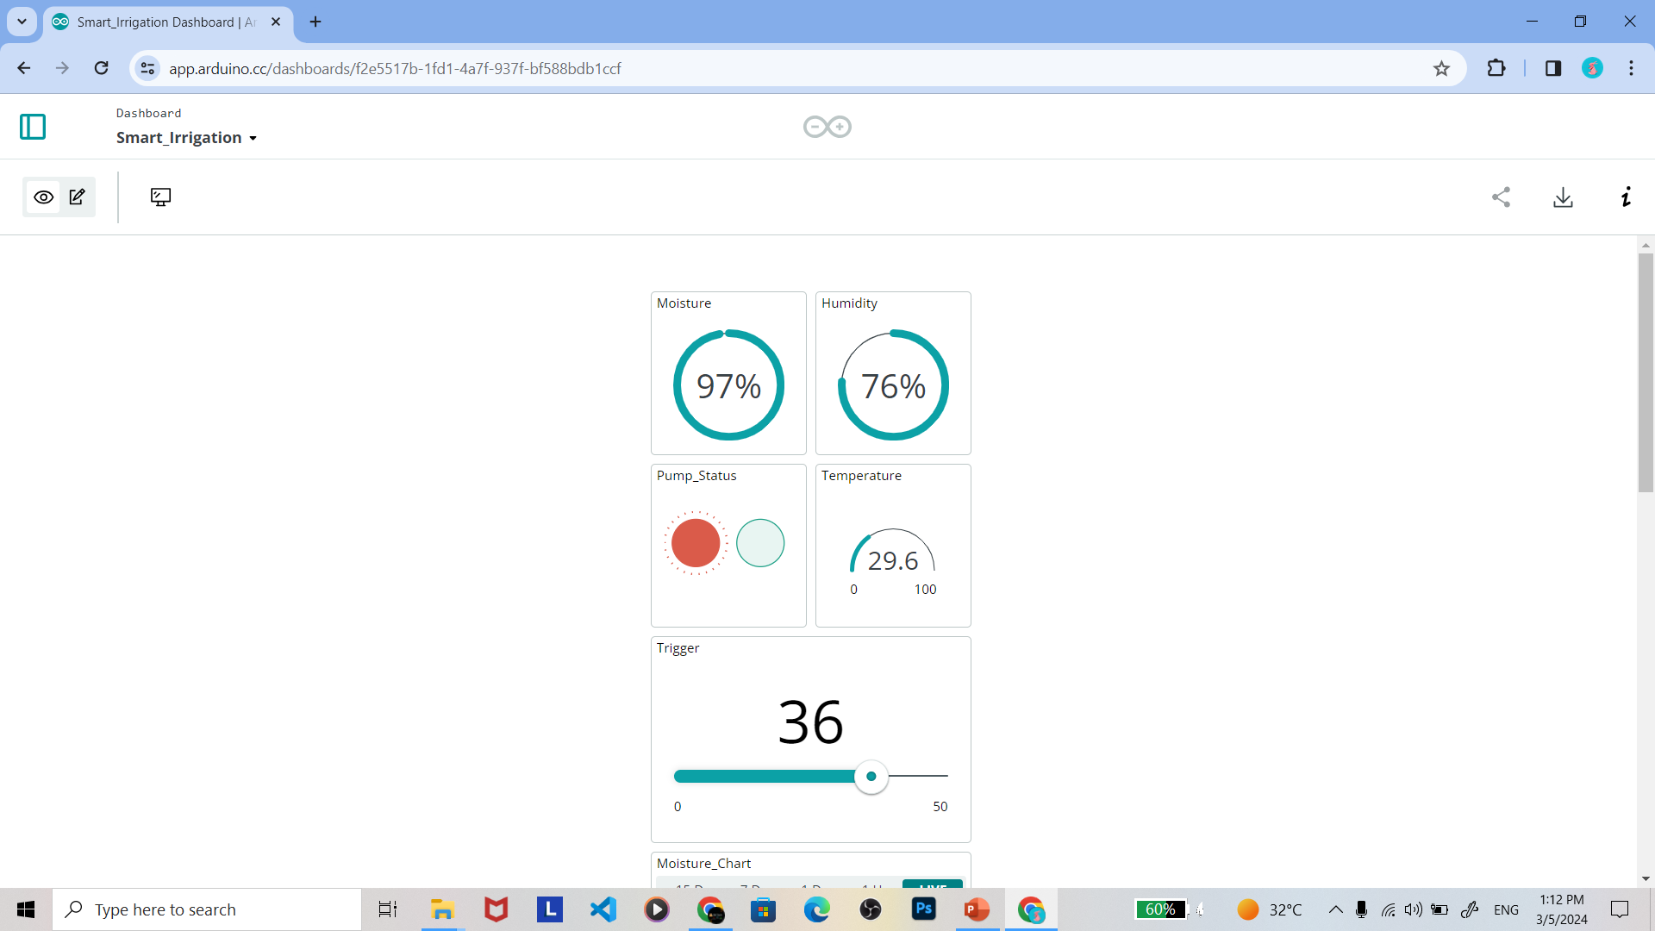
Mobile Dashboard

Slide 42
Prototype Build
Project Explanation

Slide 44
How to help Farmers through this Project
Conclusion

Slide 45
How to help Farmers through this Project

Slide 46
Final Conclusion
Conclusion

Slide 47
Final Conclusion

Slide 48
References
References

Slide 49
References
https://circuitstate.com/wp-content/uploads/2022/12/ESP32-DevKit-V1-Pinout-Diagram-r0.1-CIRCUITSTATE-Electronics-2.png
https://www.circuitstate.com/pinouts/doit-esp32-devkit-v1-wifi-development-board-pinout-diagram-and-reference/#PNG
https://lastminuteengineers.com/esp32-pinout-reference/
https://www.campuscomponent.com/blogs/post/power-supply-for-espressif-module-with-battery-charger-boost-converter#:~:text=Connecting%20the%20Voltage%20regulator's%20output,Polymer%20Battery%20can%20be%20used.

Slide 50
Thank You
Project By
Dhinesh Kumar M – 23MIA1102
G V N Kishore – 23MIA1157
Rajaa Sasidharan – 23MIA1174
Shailendra Kumar C S – 23MIA1139

